Slide 1
Effect size, significance, modeling
Brian Caffo, Jeff Leek, Roger Peng
@bcaffo
www.bcaffo.com

Slide 2
Adage
Statistical significance is not practical significance
said by every statistics instructor ever

Slide 3
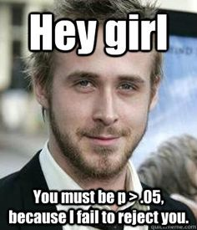
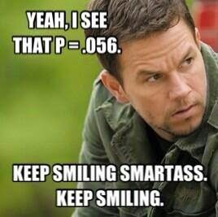
Significance
https://s-media-cache-ak0.pinimg.com/236x/1e/30/41/1e3041cbac01fb863fbd2edfc6ae9236.jpg
http://1.bp.blogspot.com/-r6q5-esz2Ws/U8fVhxXwwYI/AAAAAAAAE2E/H_pOlpYDrZE/s1600/1901960_1391097227781793_3141100807605620179_n.jpg

Slide 4
Case study 1
A very large epi study of nutrition finds a slightly significant result (p = 0.049) associating a hot dog consumption to colorectal cancer incidence
Does the large sample size bolster the evidence or hinder it?

Slide 5
Another example
A well done A/B test finds one ad campaign is not significantly better than another (p=0.056) for online purchases
Does the good study design bolster confidence in the lack of significance or not?

Slide 6
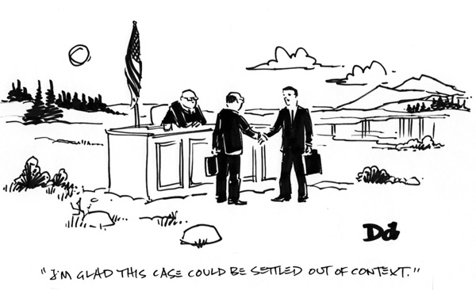
Context is important

Slide 7
Major point
The size of the effect matters.
The context of the problem matters.
What strength of evidence is required for the setting?
What level of error is tolerable?
What biases are likely present?
Multiple comparisons

Slide 8
Summary points
Hypothesis testing is a tool, but should rarely be used in isolation
There is no substitute for a critical review of results in context
Confidence intervals, study of effects should be used in addition to hypothesis tests
Three tools we’ll discuss:
Evaluate multiplicity concerns
Compare effect sizes to other known effects
Negative control (analyses where there’s known to be no association)

